Slide 1
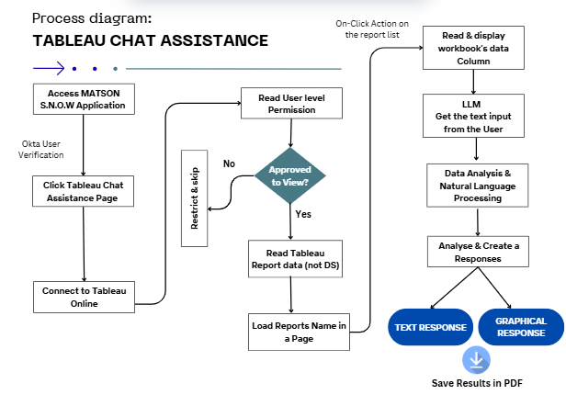

Slide 2

Background & Purpose
We recently discussed using Power BI for self-service reporting, but data readiness remains a challenge.
In parallel, I’m pursuing Gen AI Level 3 certification at Sonata, which requires a real-world PoC aligned with current work.
To support both goals, I built a small weekend PoC that enables users to interact with Tableau data lake using natural language—no need for SQL queries or fixed dashboards.
The core idea: a chat interface that returns results directly from the Tableau datasets in the data lake.
This approach complements our existing reporting setup and can potentially be integrated with the SNOW application.

Slide 3



AI Powered Data Interaction
Natural Language Queries
Intelligent Visualization
AI Powered Insights
Ask Questions in Plain English : “Show Me Top Sales by religion”.
Automatically generates charts based on your questions
Open AI GPT Provides intelligent data analysis

Slide 4

Key Benefits:
Instant access to Tableau data
Real Time Chart Generation.
Secure Tableau Integration.
Responsive web Interface
Professional Print –ready Reports
No Technical Expertise Required

Slide 5
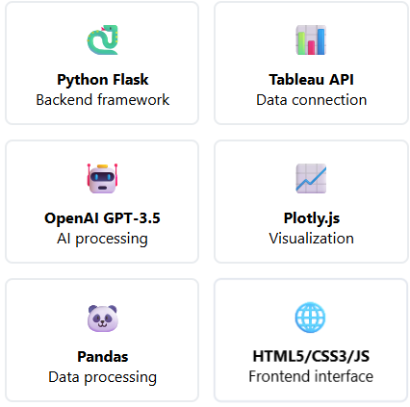
Technology Stack:
Restful API Architecture.
Secure Authentication.
Scalable cloud deployment.
Real Time Data Processing.
Automatic Chart Generation.
Automatic Data Type Conversion .
User based Report View

Slide 6
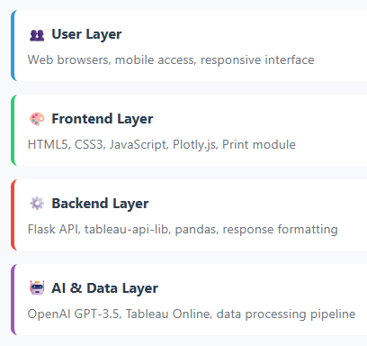
Core Components
tableau_api_lib – Tableau Server Connection
pandas - Data manipulation and analysis
numpy - Numerical operations (used by pandas)
openai - OpenAI API client
plotly - Chart generation (Python side)
matplotlib - Backend chart support
seaborn - Statistical visualization
Flask - Main web framework
and Few Utility based Libraries

Slide 7
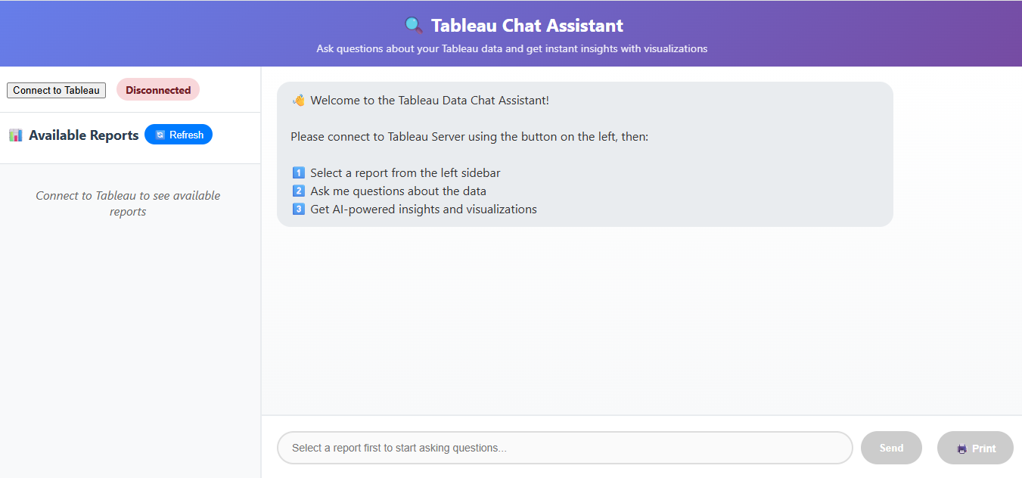

Slide 8
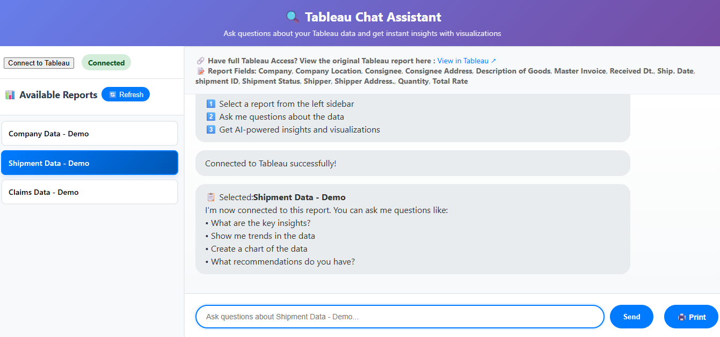

Slide 9
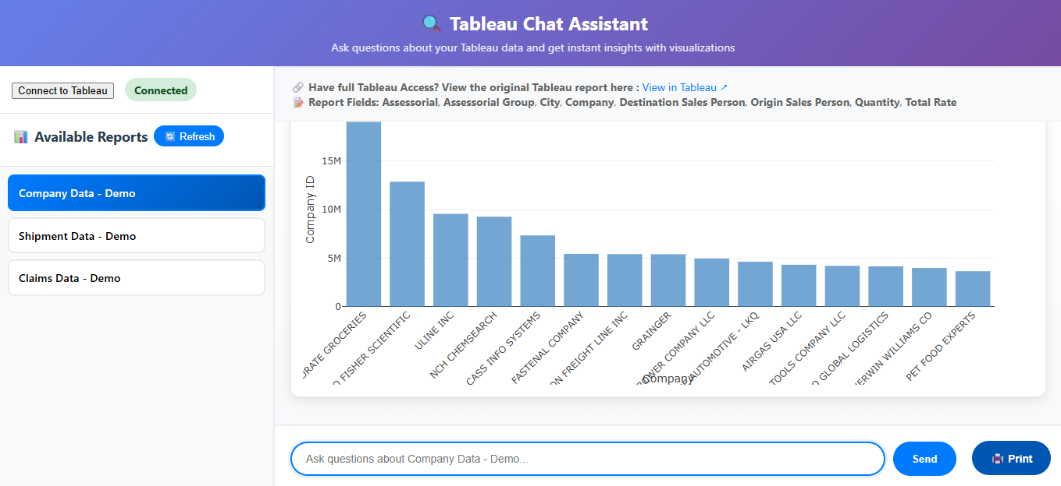

Slide 10
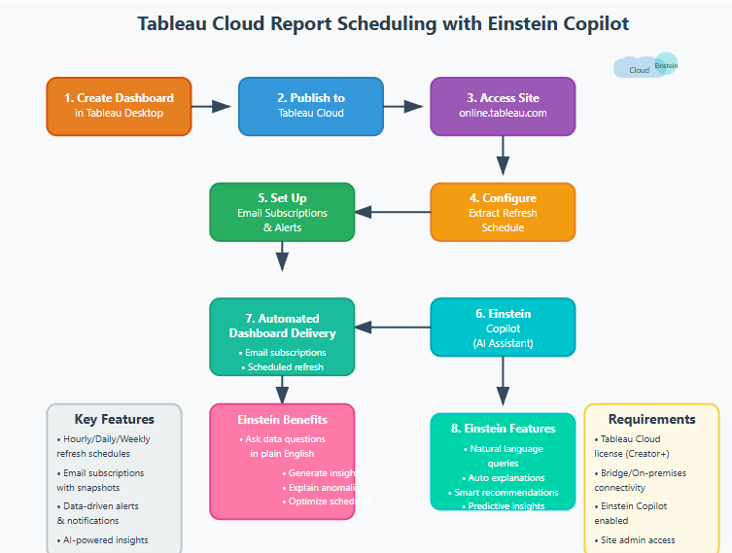

Slide 11
Tableau
Tableau Server/Cloud handles massive data volumes and real-time streaming
Advanced Analytics & Visualization
Better support for live connections with data warehouses (Snowflake, Redshift, BigQuery)
Security & Governance - LDAP/AD, strong row-level security
Works more seamlessly with Google Cloud, AWS, Snowflake, Hive, Hadoop, and other logistics tech stacks.
Hidden Cost : No Hidden Cost for all reports & Users. Advanced features (AI, paginated reports, larger dataset support).

